Slide 1
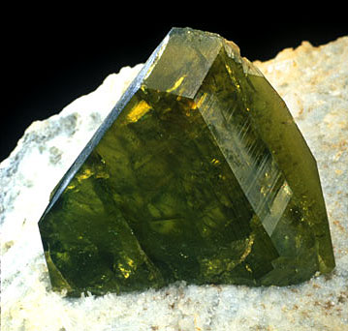
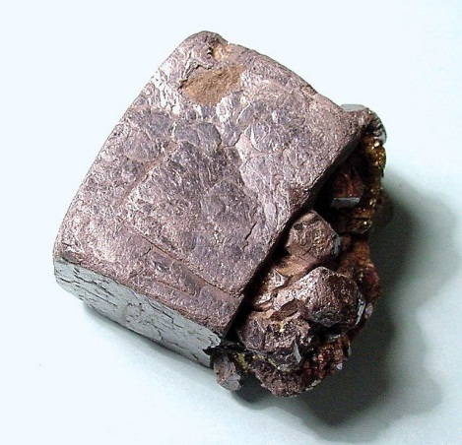
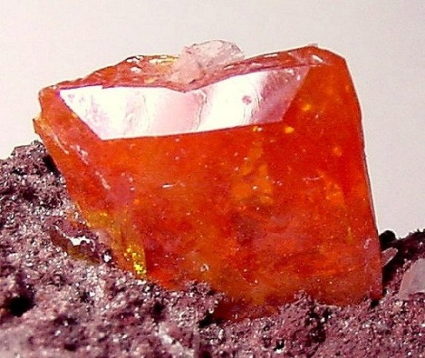
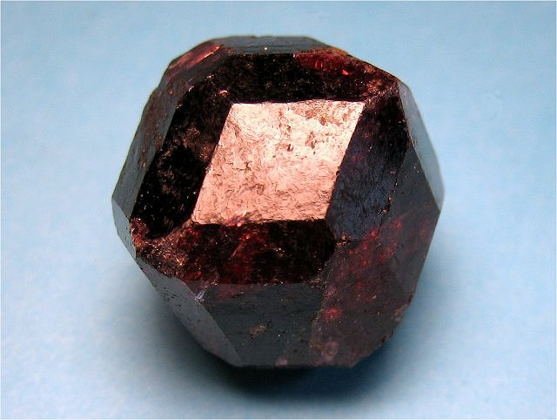
I. Minerals
Earth and Space Science

Slide 2
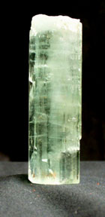
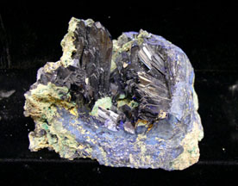
A. Definition – four part definition
→ Naturally occurring
→ Inorganic substance (non-living)
→ Crystalline solid
→ Definite chemical composition

Slide 3
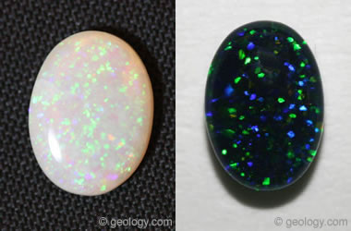
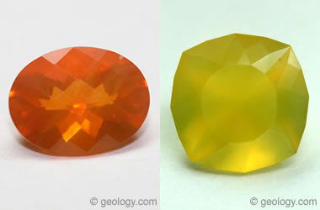
There are substances that meet 3 of the 4 criteria, and are called mineralloids
→ Example: Opal – does not have an orderly
arrangement of atoms

Slide 4
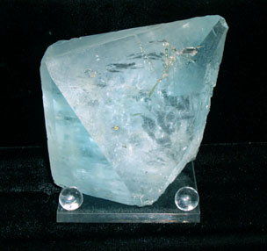
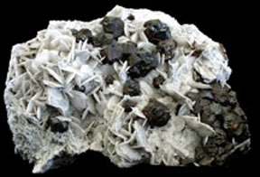
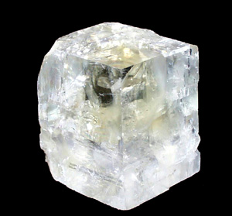
B. How many minerals are there?
- 3500 known minerals in the Earth’s crust
- Minerals combine to form all rocks on Earth
→ Rock type depends on mineral composition
20 minerals combine to form 95% of all rocks
on Earth.

Slide 5
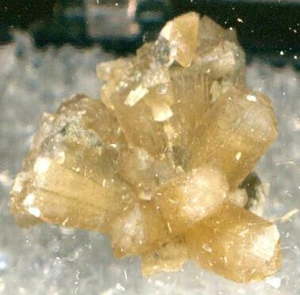
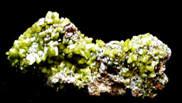
C. Physical Properties
- All minerals have at least 9 physical properties that can be used to define, describe, and identify them as unique minerals.

Slide 6
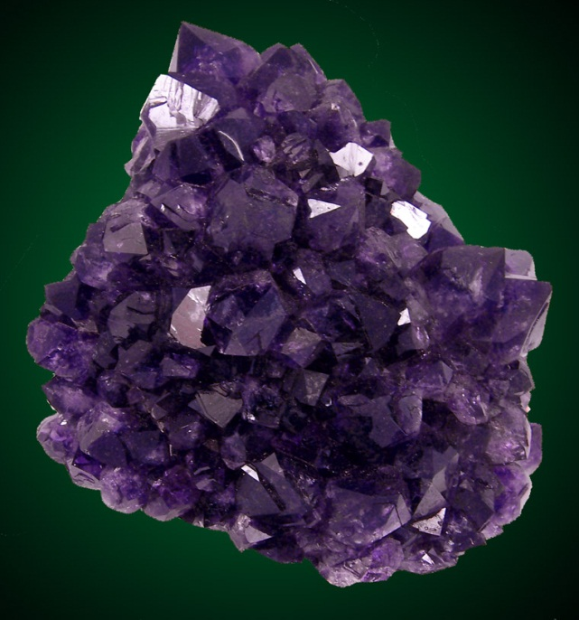
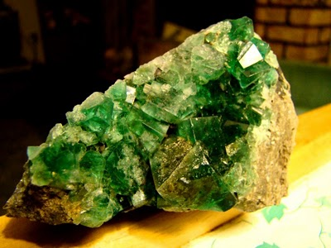
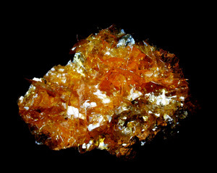
1. Color – every mineral is some color and some are found in multiple colors
→ could be very helpful and distinctive, or could be very ambiguous

Slide 7
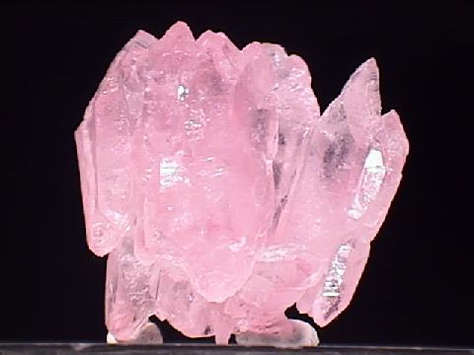
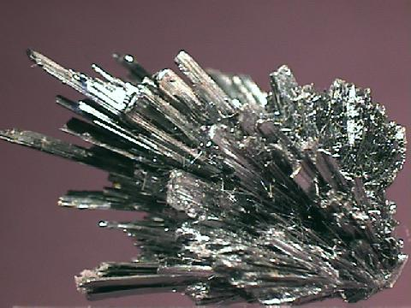
2. Luster – the manner in which a mineral
reflects light
→ Glassy – reflects light like a piece of glass does
→ Metallic – reflects light like a piece of metal does

Slide 8
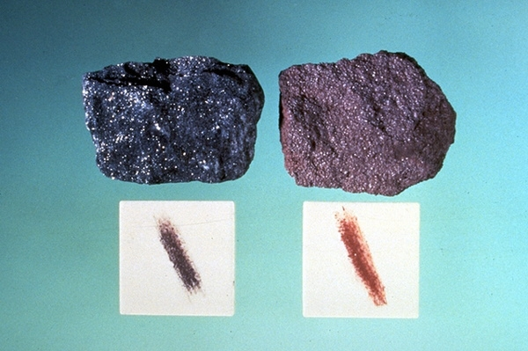
3. Streak – the color of the pulverized powder of
a mineral

Slide 9
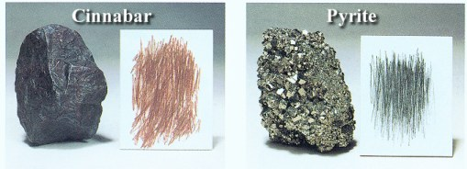
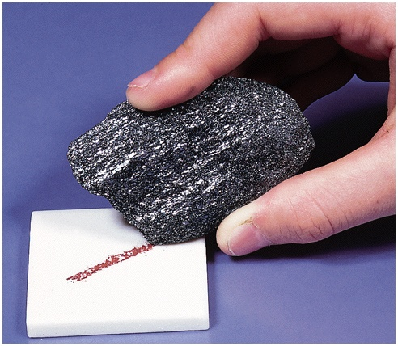
The color could be
different from the
crystal’s color, and
is always distinctive

Slide 10
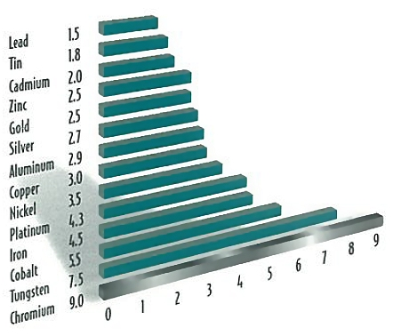
4. Hardness – the scratchability of a mineral, or a mineral’s durability
Uses the Moh’s Hardness scale with a rating
system of 1-10
*1 = very soft
*10 = hardest substance known to man
*A streak plate has a hardness of 7

Slide 11
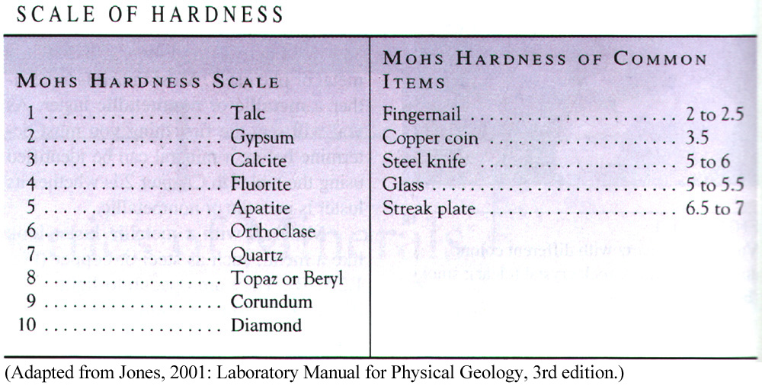
Moh’s Hardness Scale

Slide 12
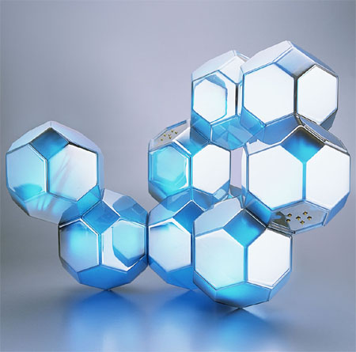
5. Crystal shape / External Crystal Form / Crystal Systems
→ a set of faces that have a definite
geometric relationship to each other

Slide 13
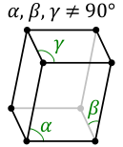
This is not always shown clearly when crystals are growing and competing for space with other minerals

Slide 14
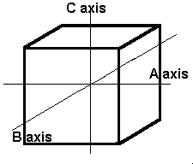
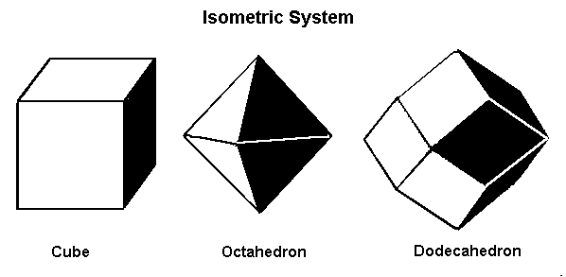
Common Face Arrangements and Angles
A. Isometric – most symmetrical
Three axes of equal length
All axes at right angles to each other

Slide 15
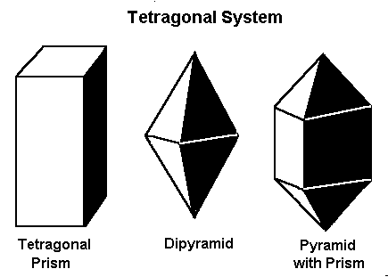
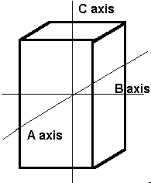
Common Face Arrangements and Angles
B. Tetragonal – similar to isometric
Three axes, two equal length, the third is longer
All axes at right angles to each other

Slide 16
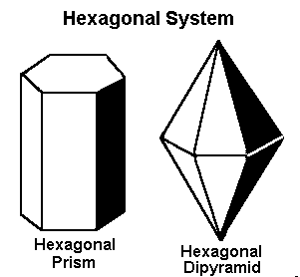
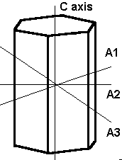
Common Face Arrangements and Angles
C. Hexagonal
Three equal axes in the same plane
Intersect at angles of 60 degrees
A fourth axis is at a right angle to the other three

Slide 17
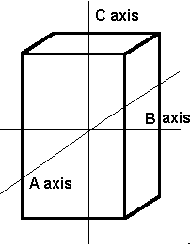
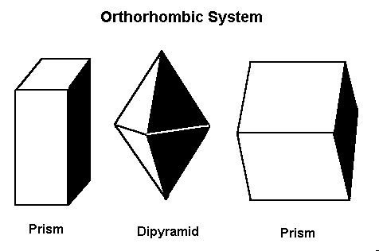
Common Face Arrangements and Angles
D. Orthorhombic
Three axes all unequal to each other
All axes intersect at right angles

Slide 18
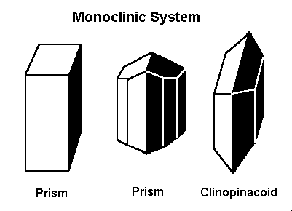
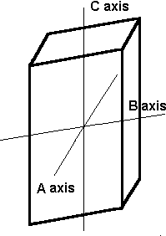
Common Face Arrangements and Angles
E. Monoclinic
Two non-equal axes at right angles to each other
A third axis is inclined to one of the first two

Slide 19
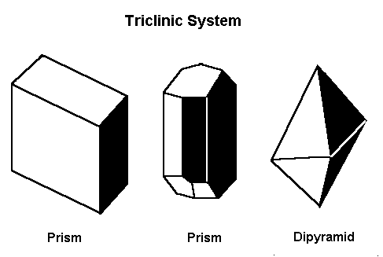
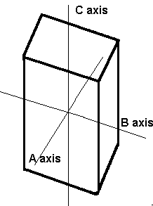
Common Face Arrangements and Angles
F. Triclinic
Three axes
All axes are inclined with respect to each other

Slide 20
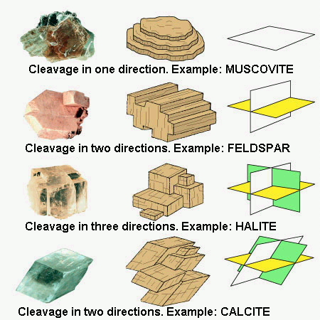
6. Mineral Cleavage – the ability of a mineral to
break, when struck along specific planes
Based on the
bonding between
atoms
Where the
bonds are
weakest =
breakage plane

Slide 21
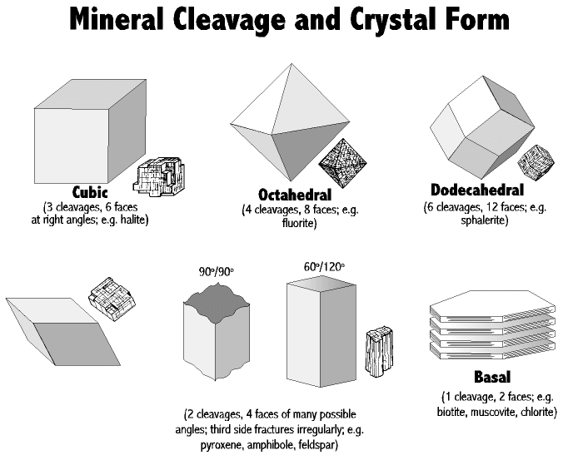
Mineral Cleavage

Slide 22
Mineral Cleavage
Can have no cleavage (example = quartz)

Slide 23
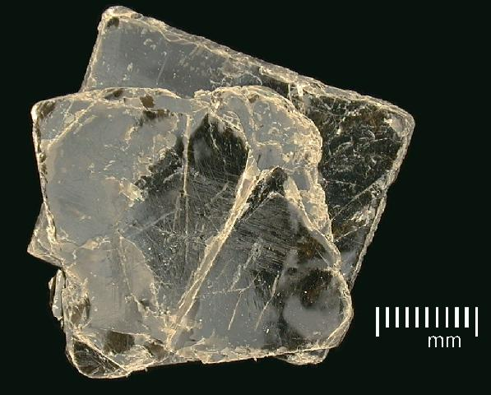
Mineral Cleavage
→ Can have 1 plane of cleavage (ex. = Biotite)

Slide 24
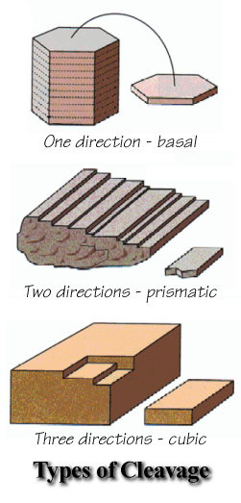
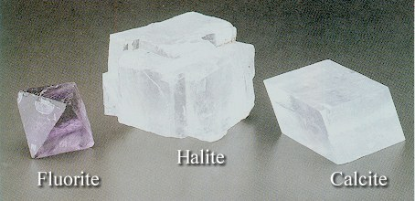
Mineral Cleavage
→ Can have multiple planes of cleavage

Slide 25
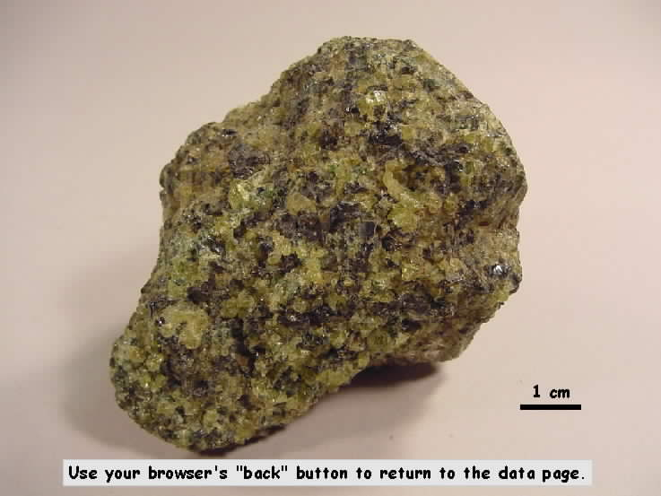
7. Fracture
The way a substance breaks where not controlled
by cleavage
Minerals with
no cleavage
generally break
with irregular
fracture

Slide 26
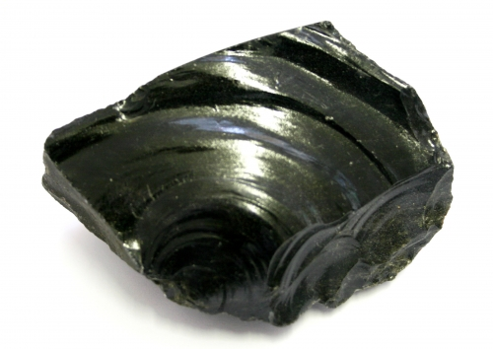
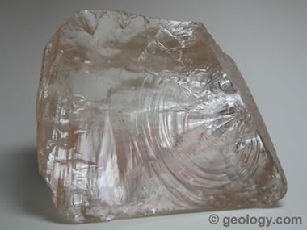
Fracture
→ If minerals break with curved fracture surfaces, it is called concoidal fracture
This is seen in glass, the igneous rock Obsidian,
and the mineral Quartz

Slide 27
8. Specific Gravity – the density of a mineral
- Density = mass of an object / volume of the object
- The ratio of the mass of an object to the mass of an
equal volume of water
- The density of pure water = 1 g / mL
- If the density of the object is < 1 = lighter than water,
and will float to some degree
- If the density of the object is > 1 = heavier than water,
and will sink
- Examples:
→ Quartz = 2.65 g / mL
→ Galena = 7.5 g / mL
→ Gold = 19.3 g / mL

Slide 28
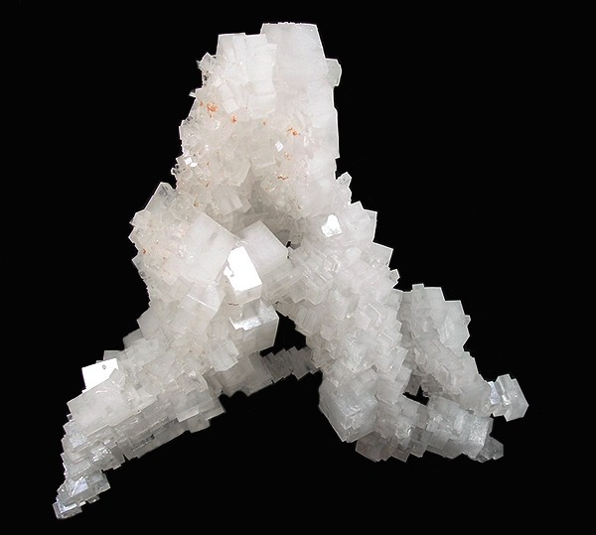
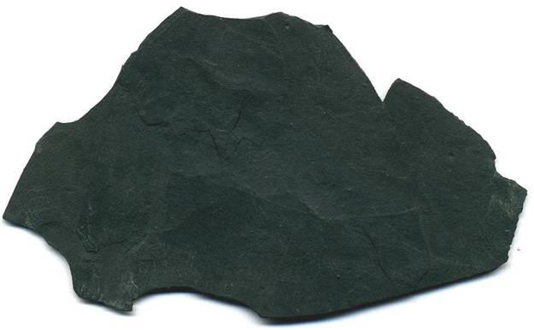
9. Other Special Properties
a. Taste – a few minerals have a characteristic taste
Halite tastes like salt
b. Odor – a few minerals have a characteristic odor
Clay minerals have an “earthy” smell

Slide 29
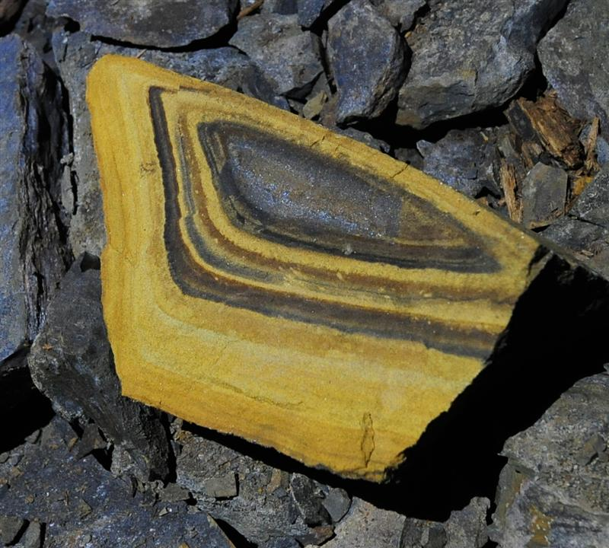
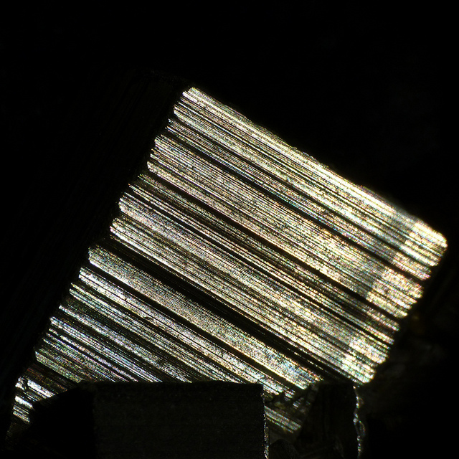
9. Other Special Properties
c. Striations – straight parallel lines on the flat surface of the cleavage directions

Slide 30
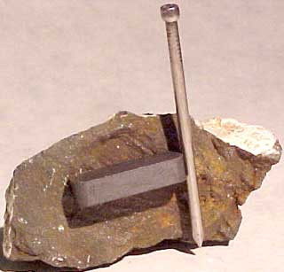
9. Other Special Properties
d. Magnetism – some minerals with large amounts of iron oxide are attracted to magnets

Slide 31
9. Other Special Properties
e. Double Refraction – a clear mineral placed over an image will show 2 images by the light being split as it
enters some
crystalline minerals
→ Example - Calcite

Slide 32
9. Other Special Properties
f. X-ray fingerprints – when x-rays are directed through minerals, the x-rays are deflected out at specific angles
→ Each mineral has a specific pattern

Slide 33
9. Other Special Properties
g. Chemical tests – how do minerals react to specific chemicals
Example –
Carbonate minerals (calcite) will react to
weak hydrochloric acid, they will fizz to
produce carbon dioxide (CO₂) gas

Slide 34
→ Generally this is the only field chemical test

